Slide 1






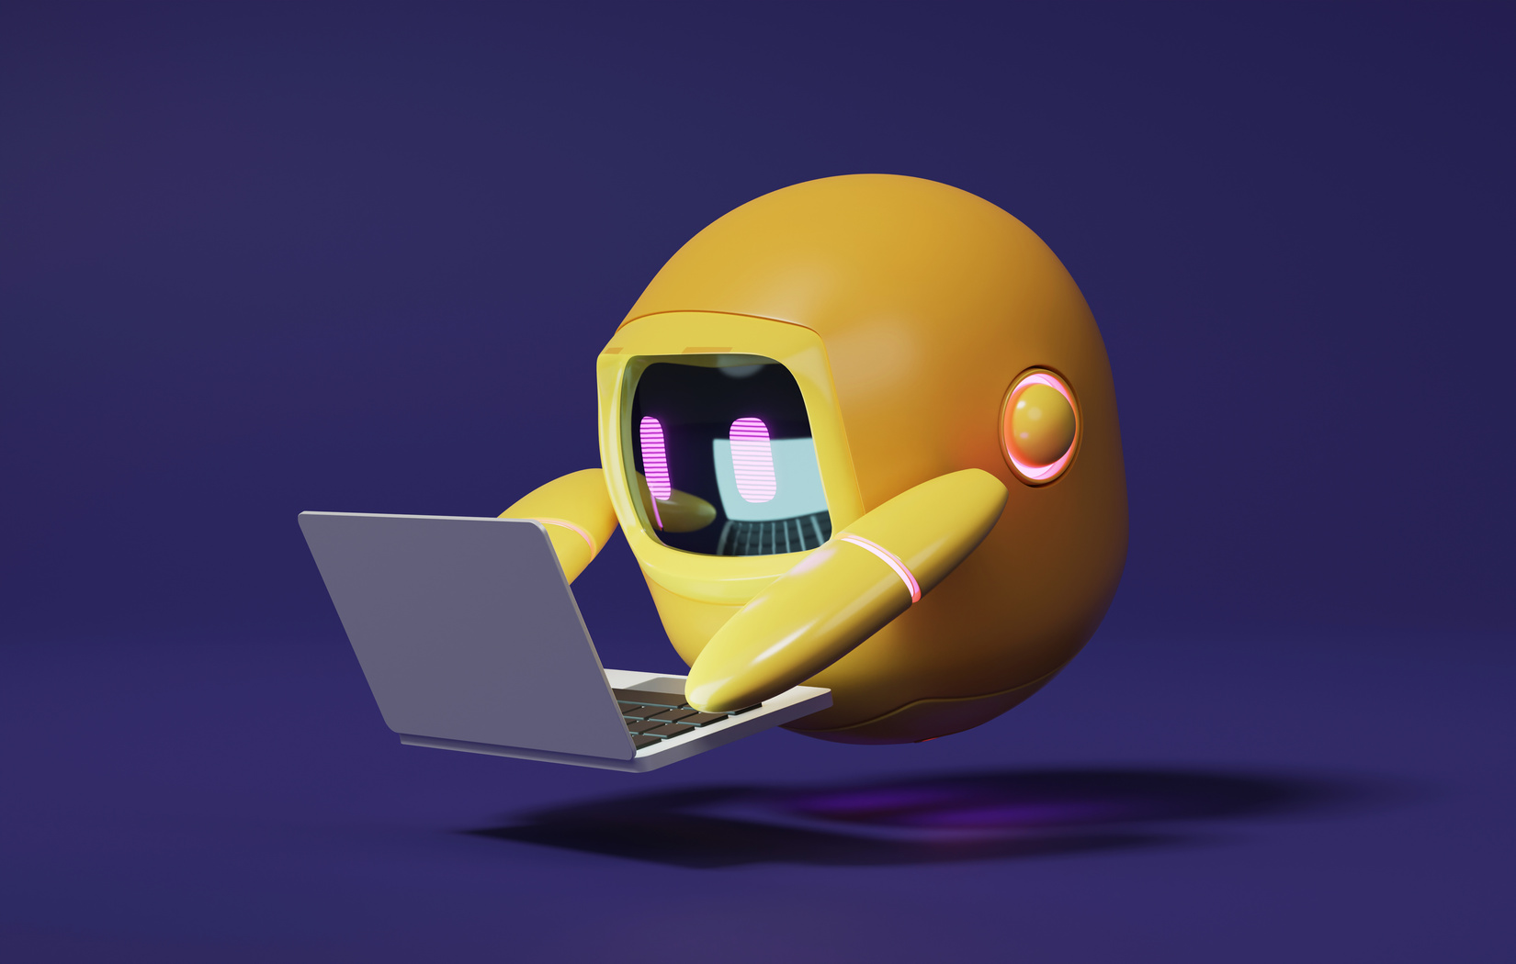

A 2-days National Level Hackathon on
AI in education
: Joint Entrance Examination
Team Name :
Spade-19
Date – 05/09/2025
Sagar Institute Of Research & Technology – Excellence, Bhopal
www.samadhan.sistec.ac.in/

Slide 2


Levels:
, Mathematics
AREA OVERVIEW
Full Name: Joint Entrance Examination (JEE)
Conducted By: NTA (National Testing Agency)
JEE Main – Admission to NITs, IIITs, and as qualifying exam for JEE Advanced
JEE Advanced – Admission to IITs
Subjects : Physics, Chemistry, Mathematics
IMPORTANCE OF AREA
JEE exam opens the gateway to India’s top
Engineering Colleges like IITs and NITs

Slide 3

Main Problem
IIT JEE is considered one of the toughest exams in India, and during its Preparation students face many challenges such as.
Difficulty in managing time with the vast syllabus
Struggles in building strong conceptual clarity
Pressure of intense competition
Loss of motivation during preparation
Feeling of loneliness and isolation
Difficulty in balancing coaching, self-study, and school work
Overall preparation journey becomes highly stressful

Slide 4

Potential Challenges and Opportunities
IIT-JEE known for its highly competitive, the exam test a student’s knowledge Of PCM at an advanced level.
Artificial intelligence is transforming JEE preparation by providing personalized learning paths, smart mock tests and instant feedback.

Slide 5

Preliminary Solution Concept
AI-powered platform to evaluate student’s performance in real time based on mock test results
Provides an integrated space for peer collaboration
Helps students solve doubts collectively
Ensures personalized performance tracking
Promotes group-based learning support

Slide 6

Key Features and Functionalities
Voice command Recognition with Bilingual Support
Real time doubt solving with Multimedia Input
Tracking Real Time Progress using mock test
Group Collaboration help for make a Study Room
Teach topic by best Visuals and Diagrams

Slide 7

Target Users and Expected Use Cases
Students preparing for IIT-JEE often struggle due to lack of proper guidance, clear direction, and structured study methods

Slide 8
AI Technologies and Methods
Frontend and UI/UX – React , Tailwind CSS and P5.js , Figma
Backend – Node.js + Express.js , JWT(JOSN Web Tokens) and Socket.io
API – REST APIs, AI integration (Gemini API) and Google TTS & STT (Text to speech and speech to text)
AI Approach and Database – NumPy, Pandas , Scikit-learn, TensorFlow, NLP ,MongoDB

Slide 9
Implementation Approach
We will follow a custom SDLC approach.
Initial focus will be on building the core system first.
Once the backbone is stable, we will add features one-by-one.
Features will be prioritized from hard to easy.

Slide 10
Requirement Analysis
Most Difficult Module
Module - 1
Module – 2
Module - 3
Planning Designing
Integrating with core
Integrating with core
Integrating with core
Development Core Part
Testing & Deployment
Core Part
Core Part
Core Part
The most challenging components will be developed first, such as:
1. AI-driven performance tracking
2. Real-time group interaction
Solving these core challenges early ensures complex logic is handled at the start.
Once the hard parts are complete, easier feature add-ons will be gradually integrated.
[]P}

Slide 11
Expected Outcome
The expected outcome of this project is a learning platform that helps students improve their efficiency.
Key outcomes include:
1. Personalized mock test tracking to boost learning efficiency.
2. AI-powered and peer-based doubt solving for better understanding.
3. Group engagement features to keep students motivated.
Smart analytics providing valuable insights on student performance.
User-friendly design ensures a smooth experience for all users.

